Slide 1


PROBLEM STATEMENT
PS ID: SIH1283
PS TITLE: DIGITAL ASSISTANT FOR LEGAL AWARENESS AND DESIGNING A KYR KNOW
-YOUR -RIGHTS FRAMEWORK IN INDIA
INSTITUTE NAME:AJAY KUMAR GARG
ENGINEERING COLLEGE , GHAZIABAD
TEAM: Binary Brains 2.0
TEAM
ANSHU(Leader)
Akshat Pratap Singh
Vaishali Tiwari
Abhinav Sharma
Amit Maurya
Akanksha Singh

Slide 2
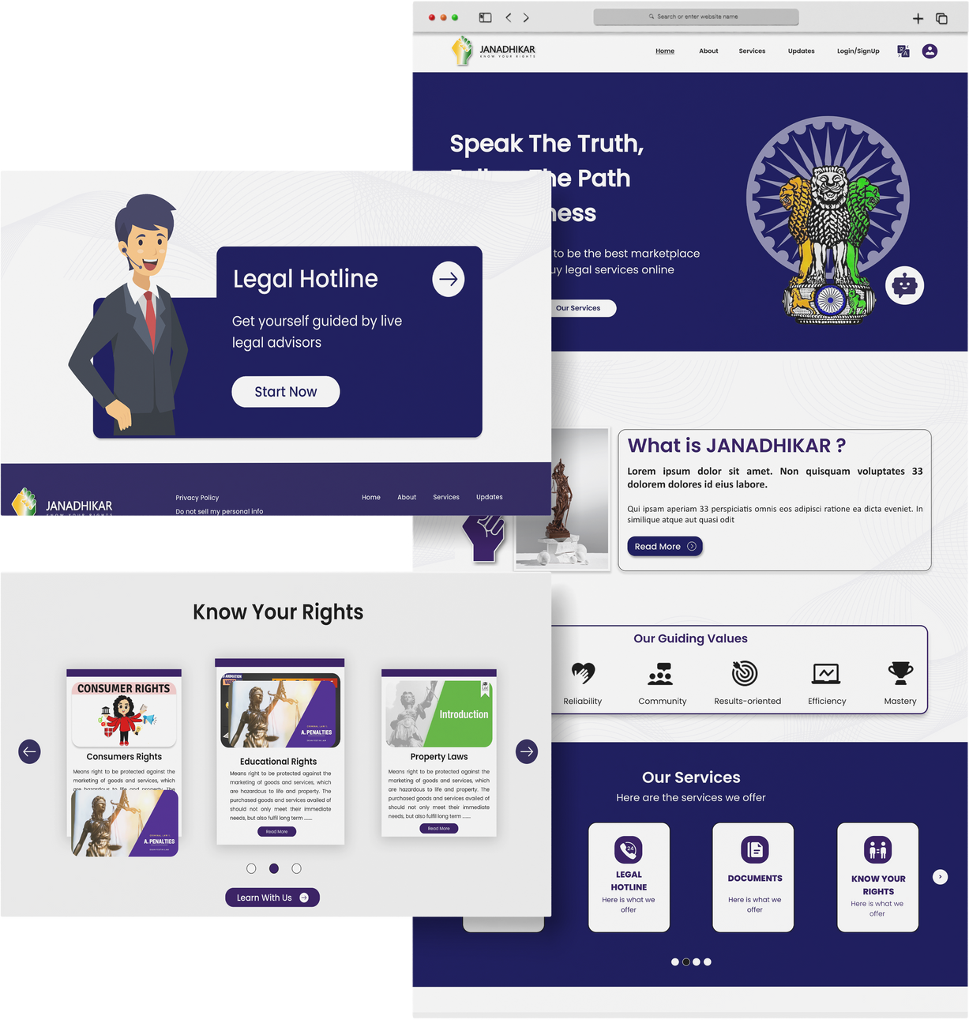
HOME PAGE
OUR FEATURES
Feedback
Text-to-speech
Multilinguistic system
OUR SERVICES
Calling
Search By image
Legal Hotline
Documentation
Know your Rights
Legal Aid and services
Jan Sevak (digital assistant)
Study module
Updates

Slide 3

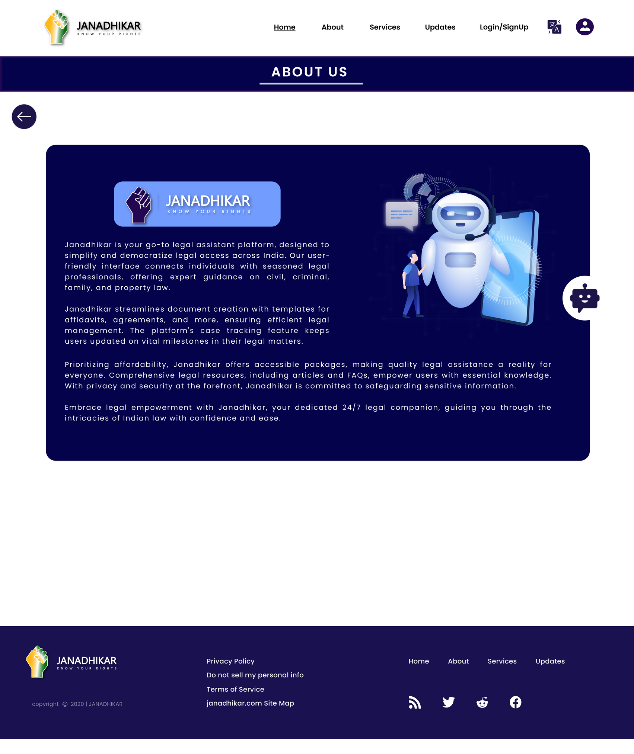
ABOUT US
Here are the details about our Platform "JANADHIKAR" , which is designed to create awareness about rights of people in India

Slide 4
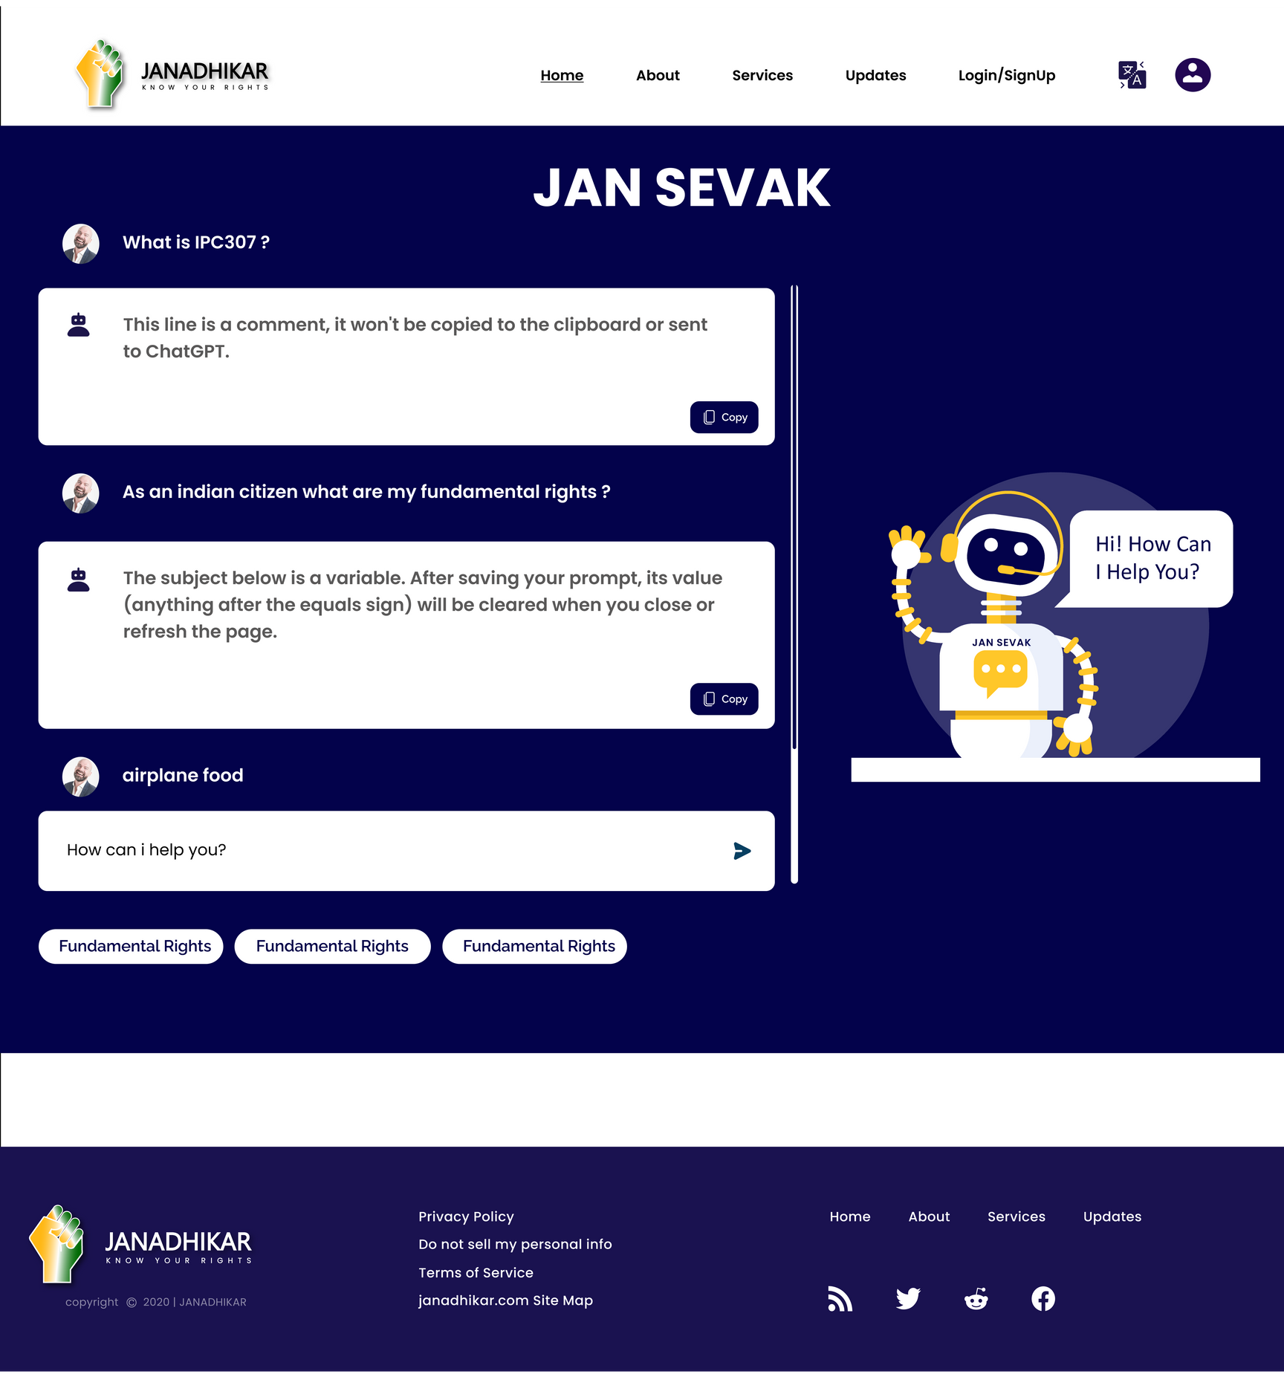
WHAT IS JAN SEVAK?
A digital Legal Assistant that can provide legal information and guidance to people
It is able to converse in multiple languages
It is your 24/7 legal companion
It supports text -to- speech and speech -to- text feature

Slide 5
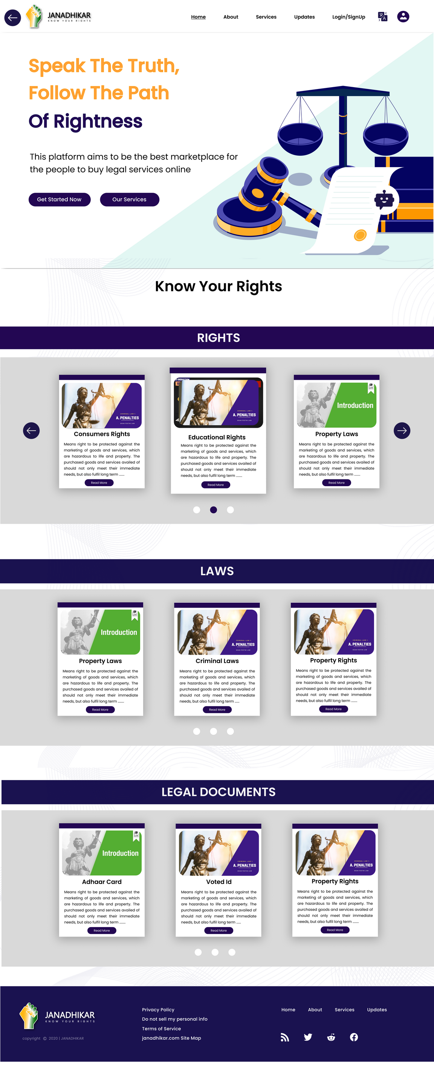
KNOW YOUR RIGHTS
Simplifies the process of understanding your rights and entitlements
Through this user can easily understand about
their laws

Slide 6


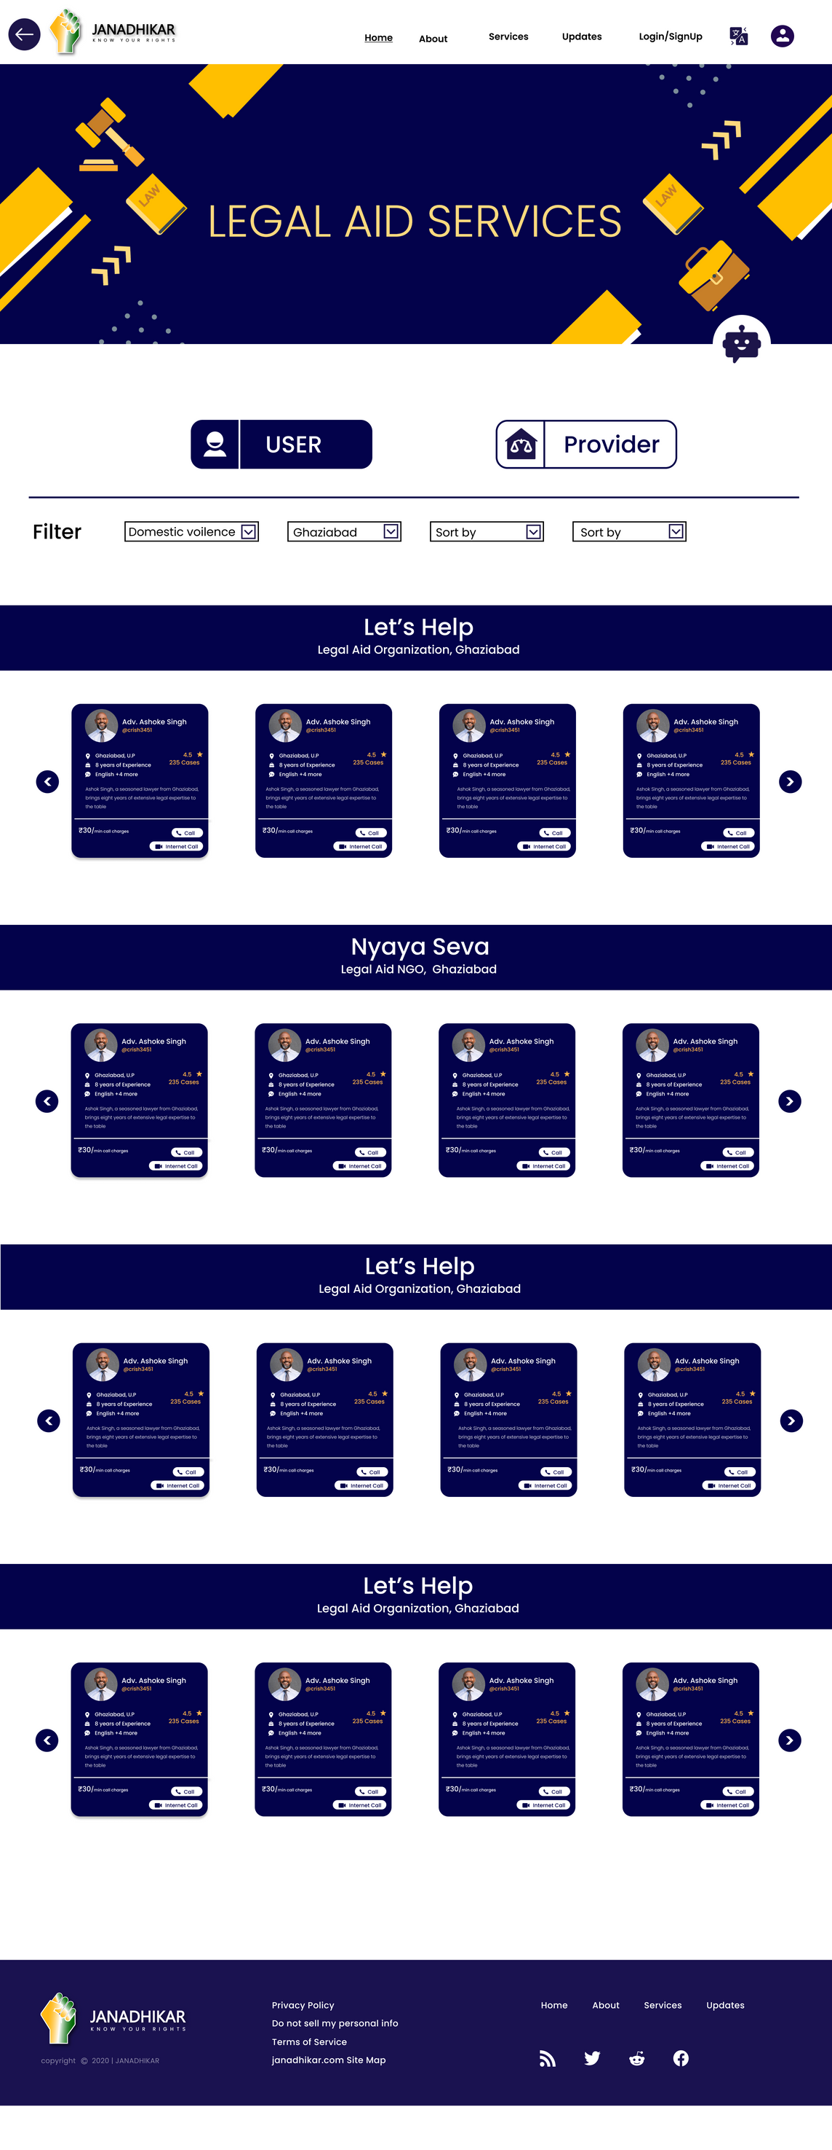
LEGAL HOTLINE
NYASEVA
Immediate Assistance
Access to Legal Experts
Confidentiality
User-friendly Interaction
Scalaibility and Sustainlability
Integration with Know Your Rights framework

Slide 7

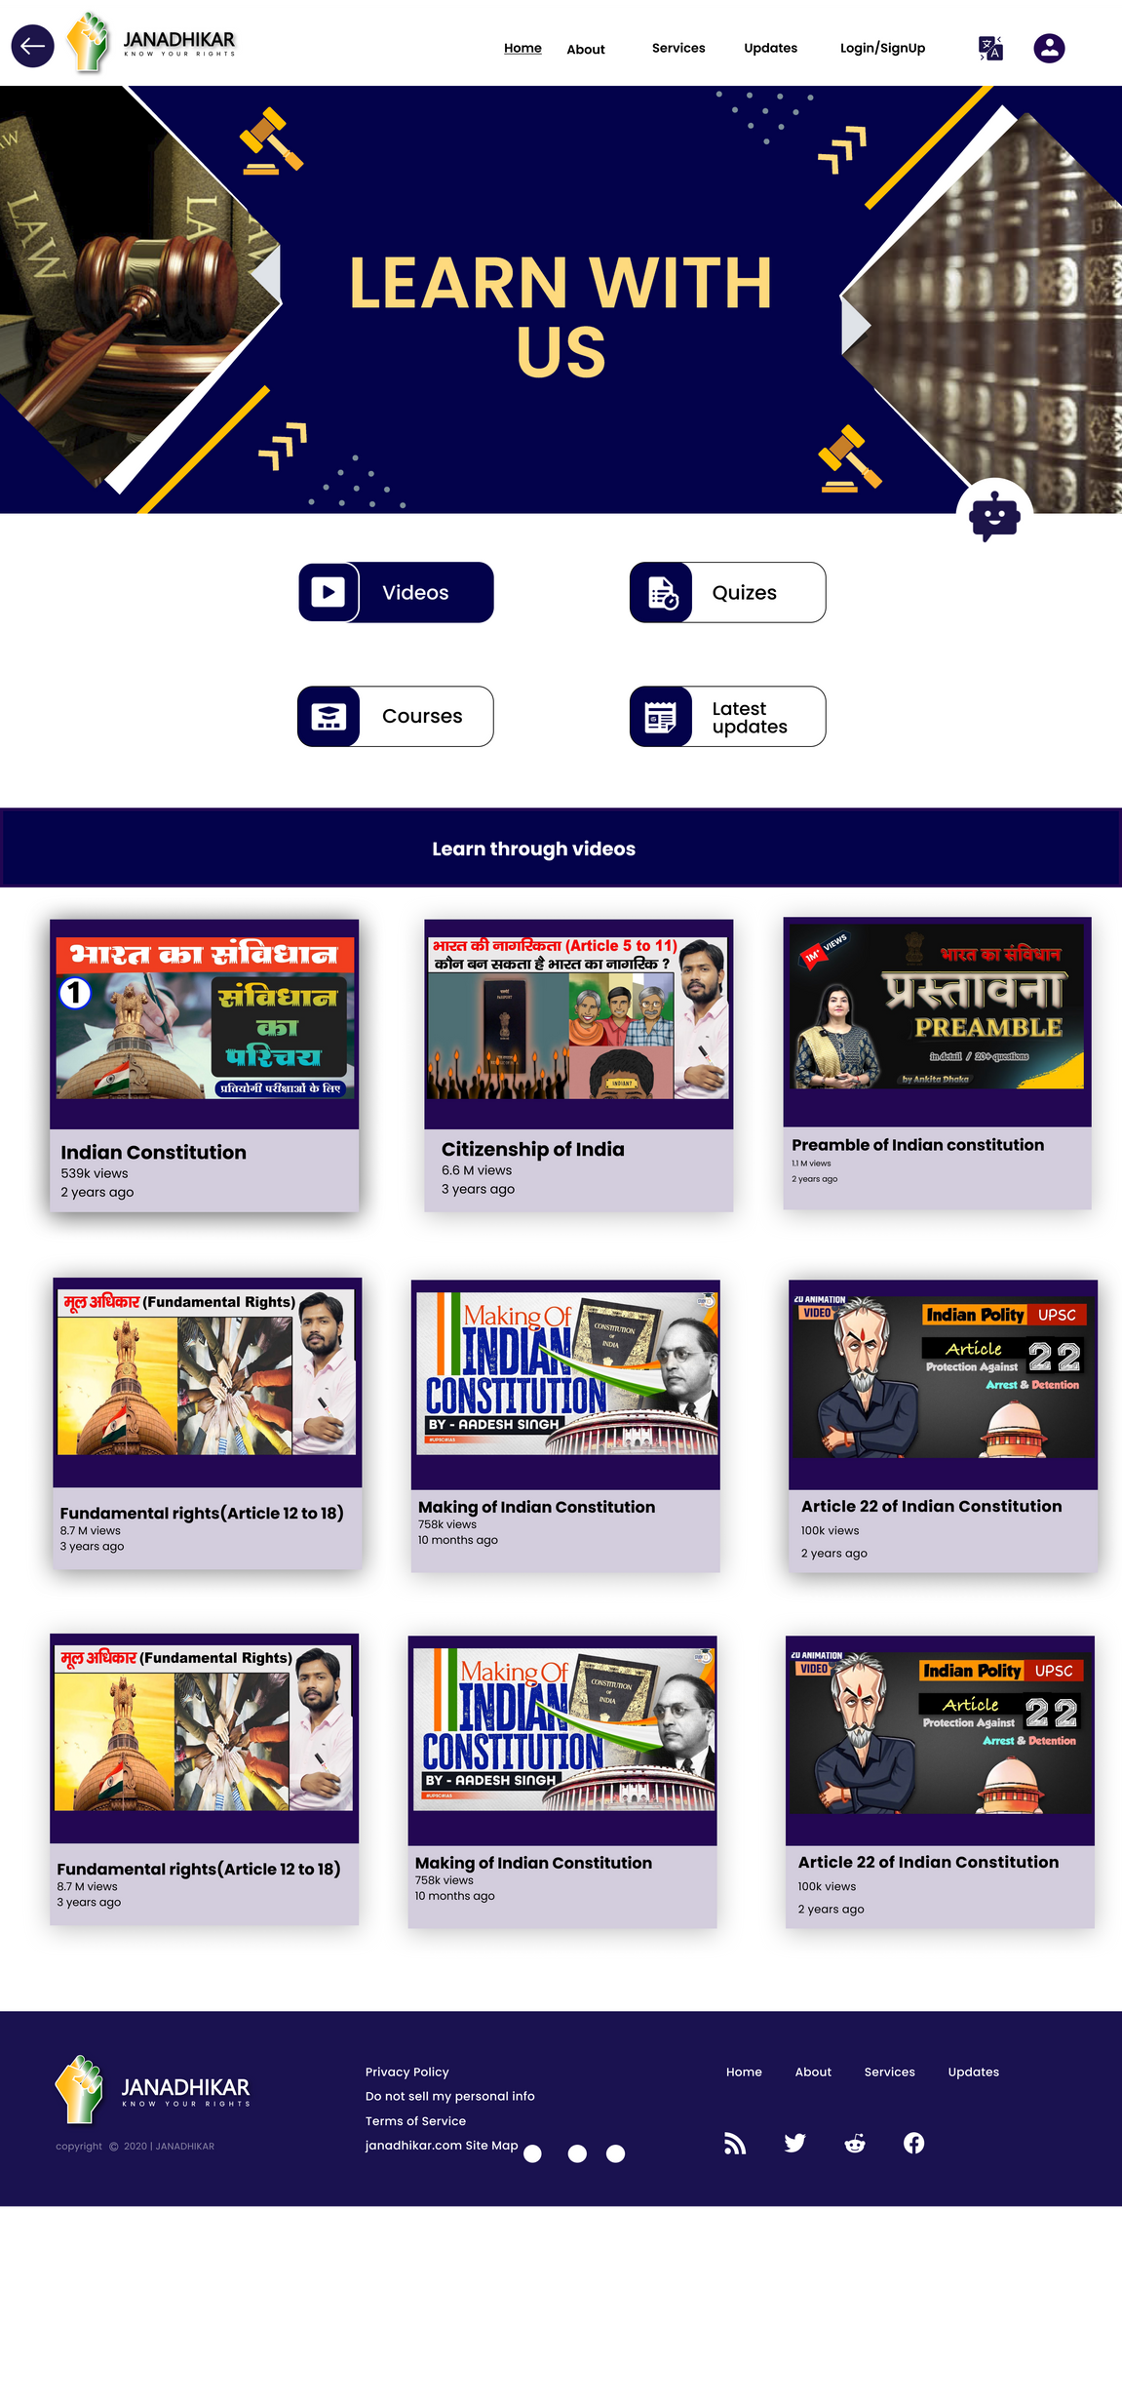
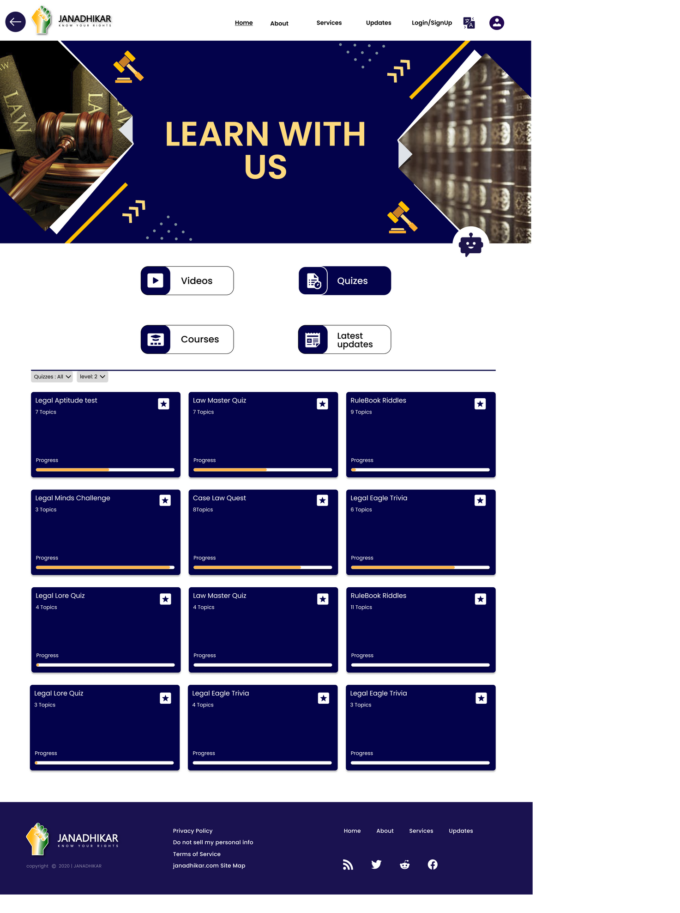
LEARN WITH US
Through this user can learn about their rights though various methods:
Courses
Videos
Quiz

Slide 8
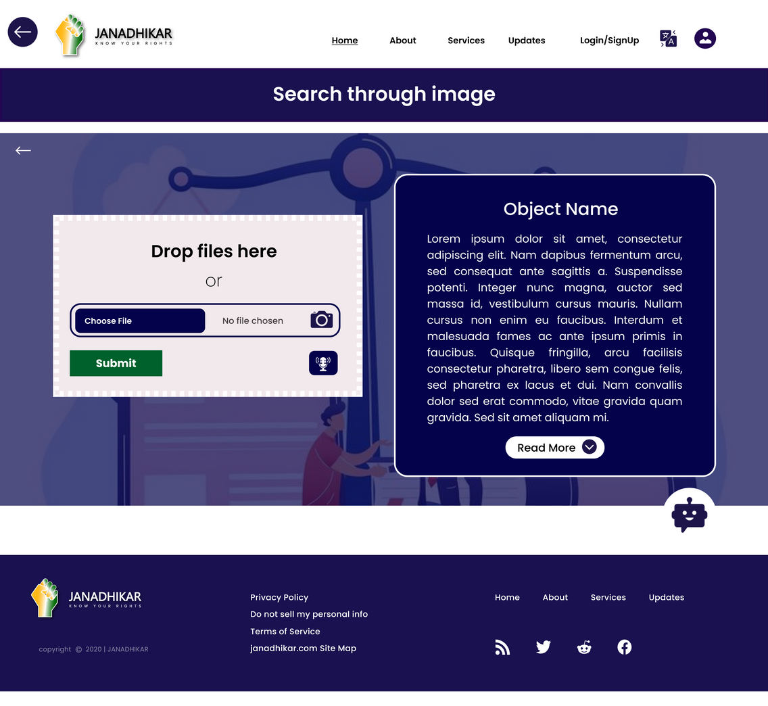
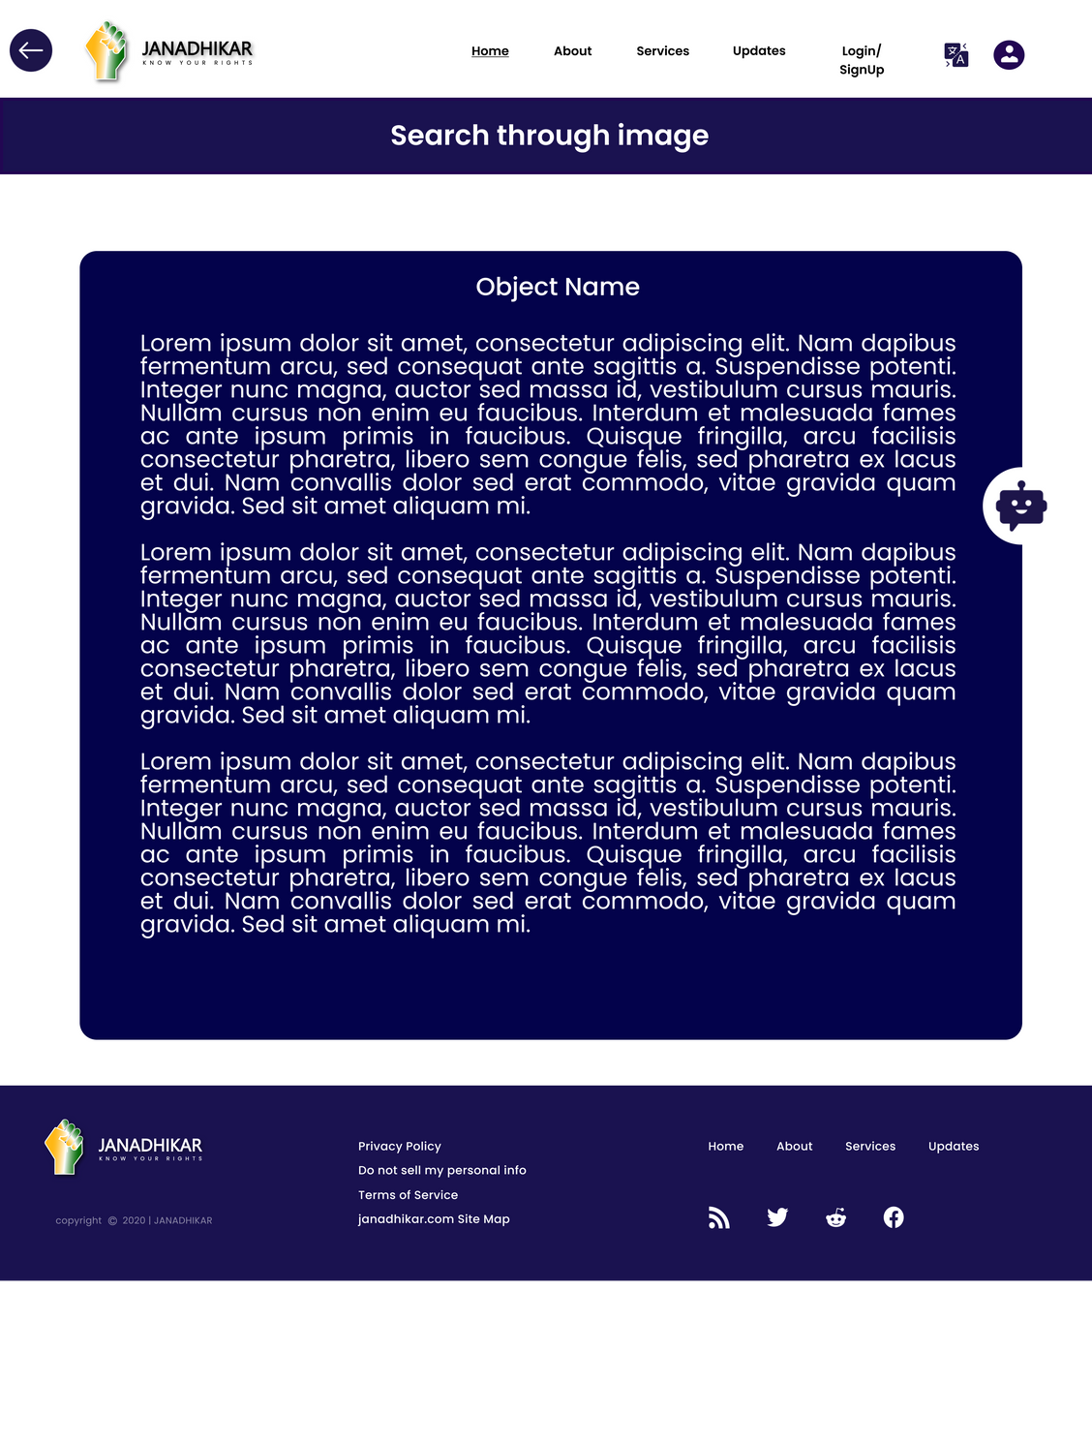
SEARCH THROUGH IMAGE
Search any law or rights just by uploading the image
Search their law by clicking the picture

Slide 9
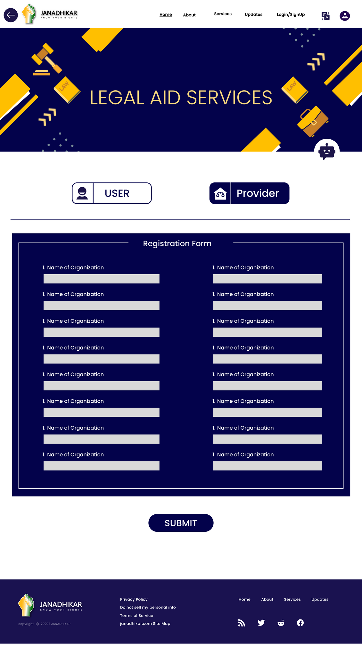

LEGAL AID SERVCES
This section display the organisations which provides free legal services
targets poor and marginalized communities

Slide 10
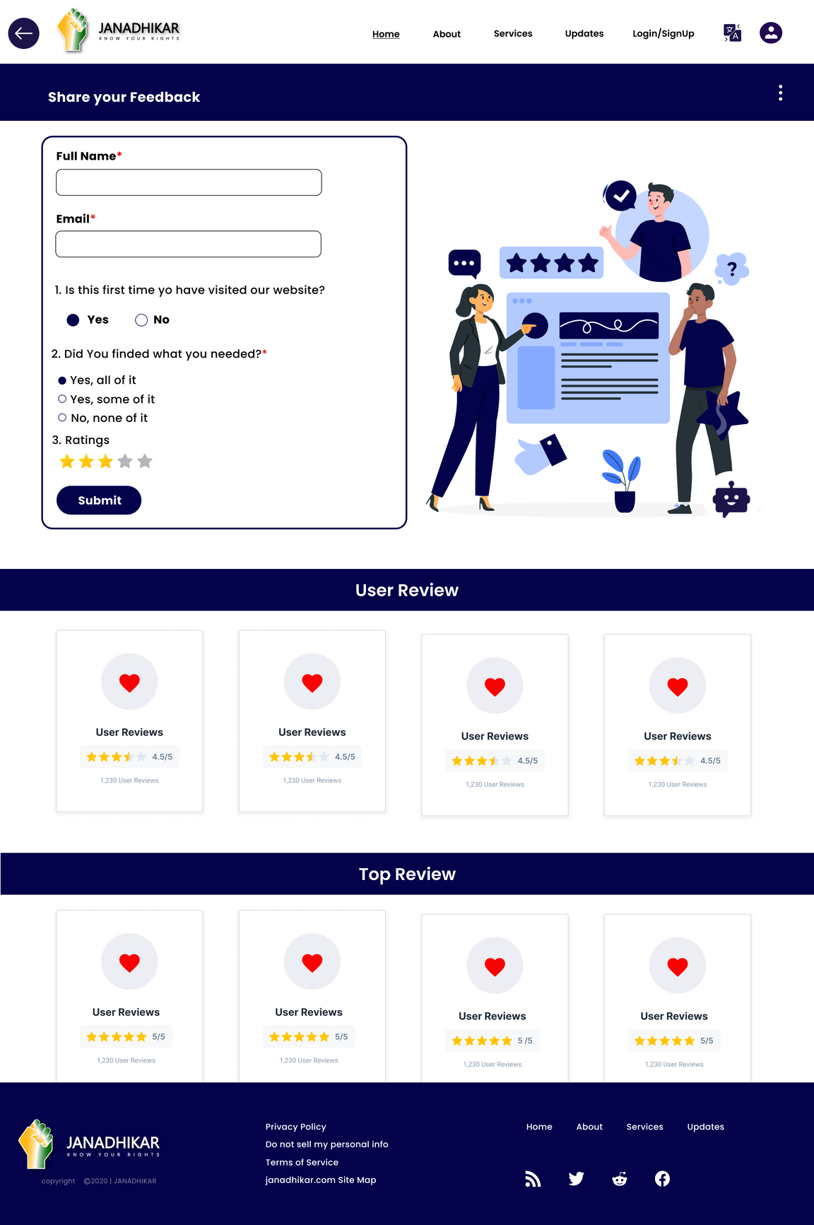
FEEDBACK
User can share the feedback for the service
Help us understand user needs
Help us to improve platform services

Slide 11
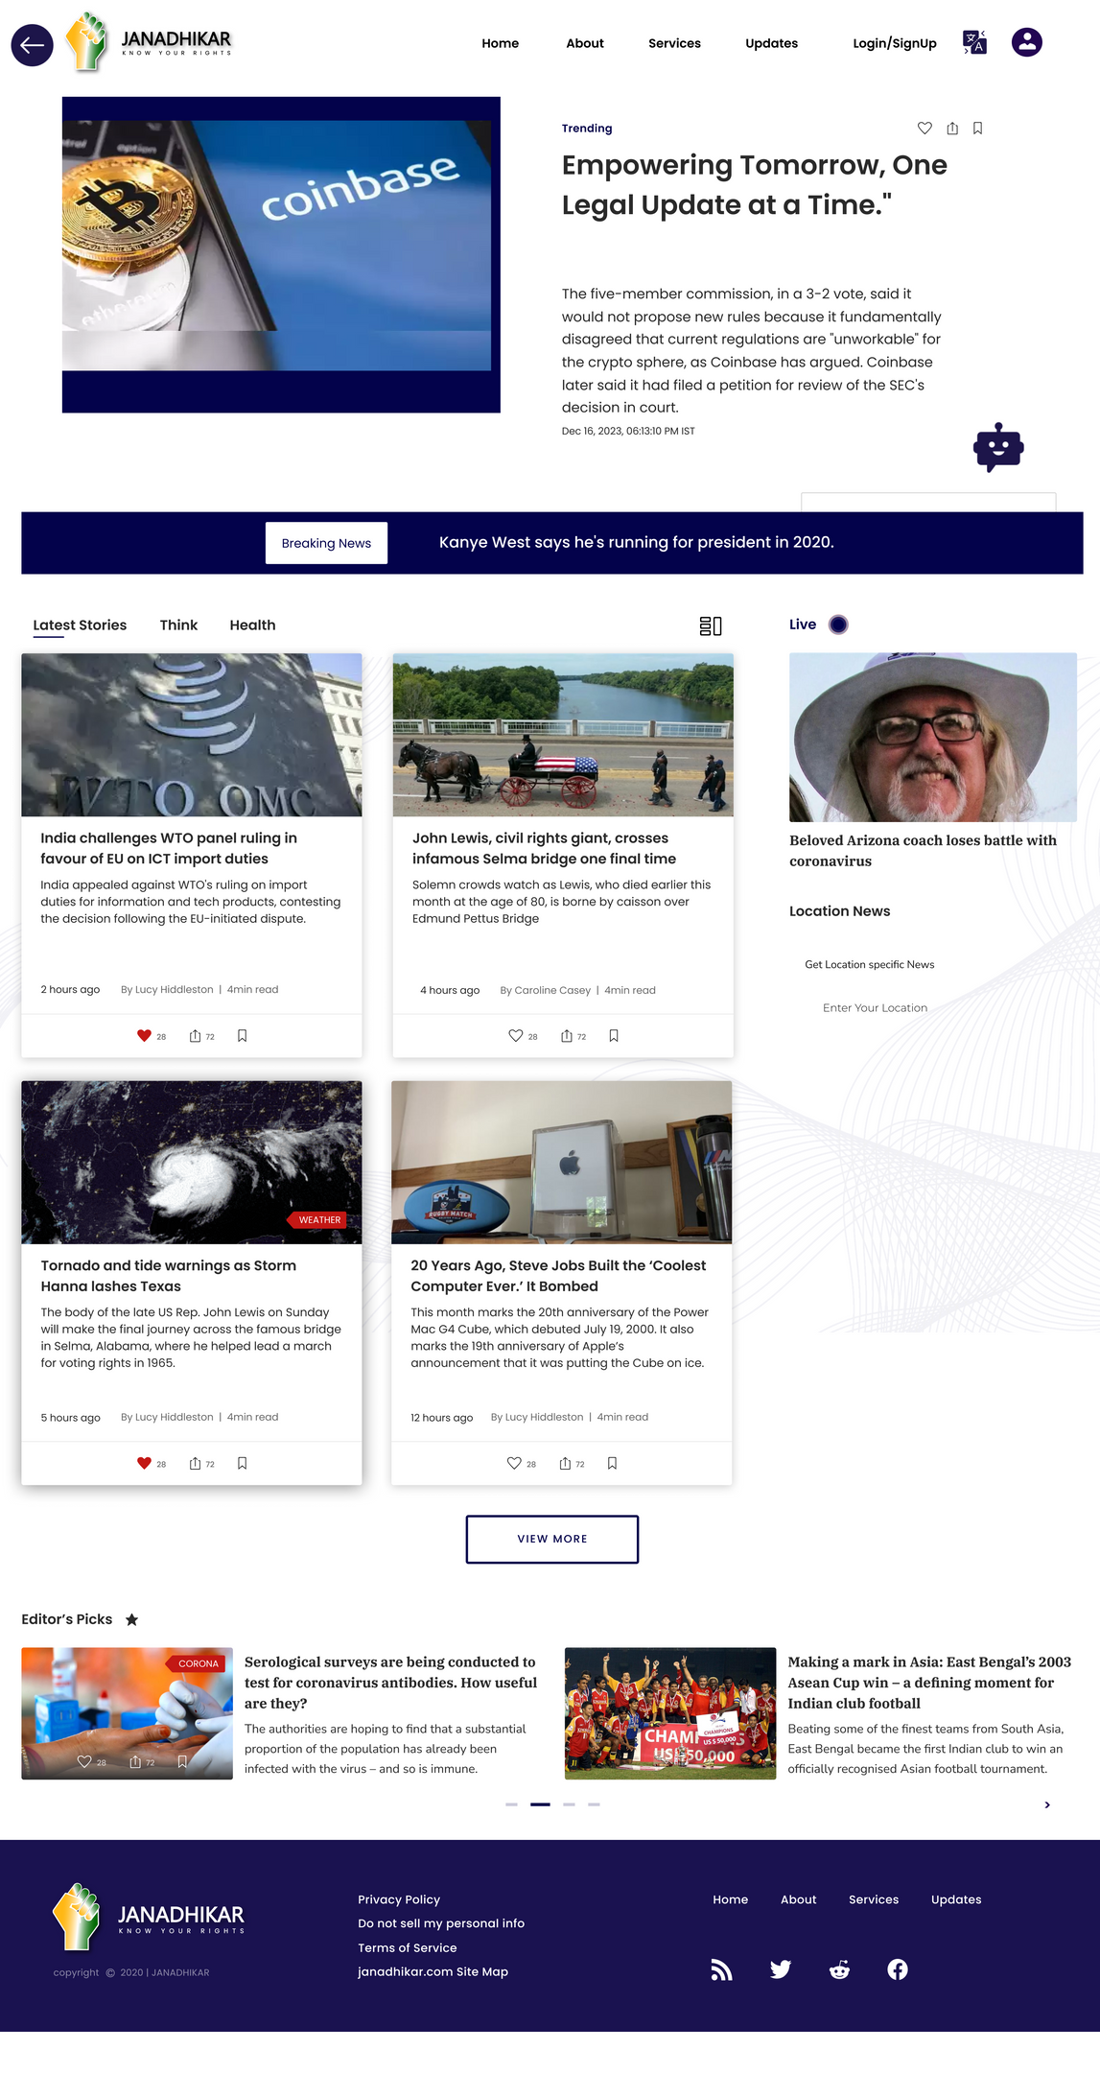
UPDATES
Inform the users about any amendment in laws
Give updates about any information of new law

Slide 12
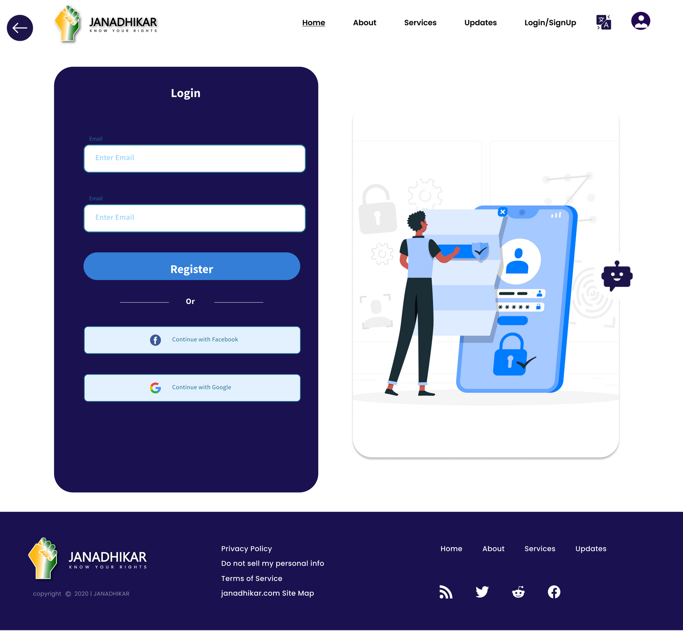
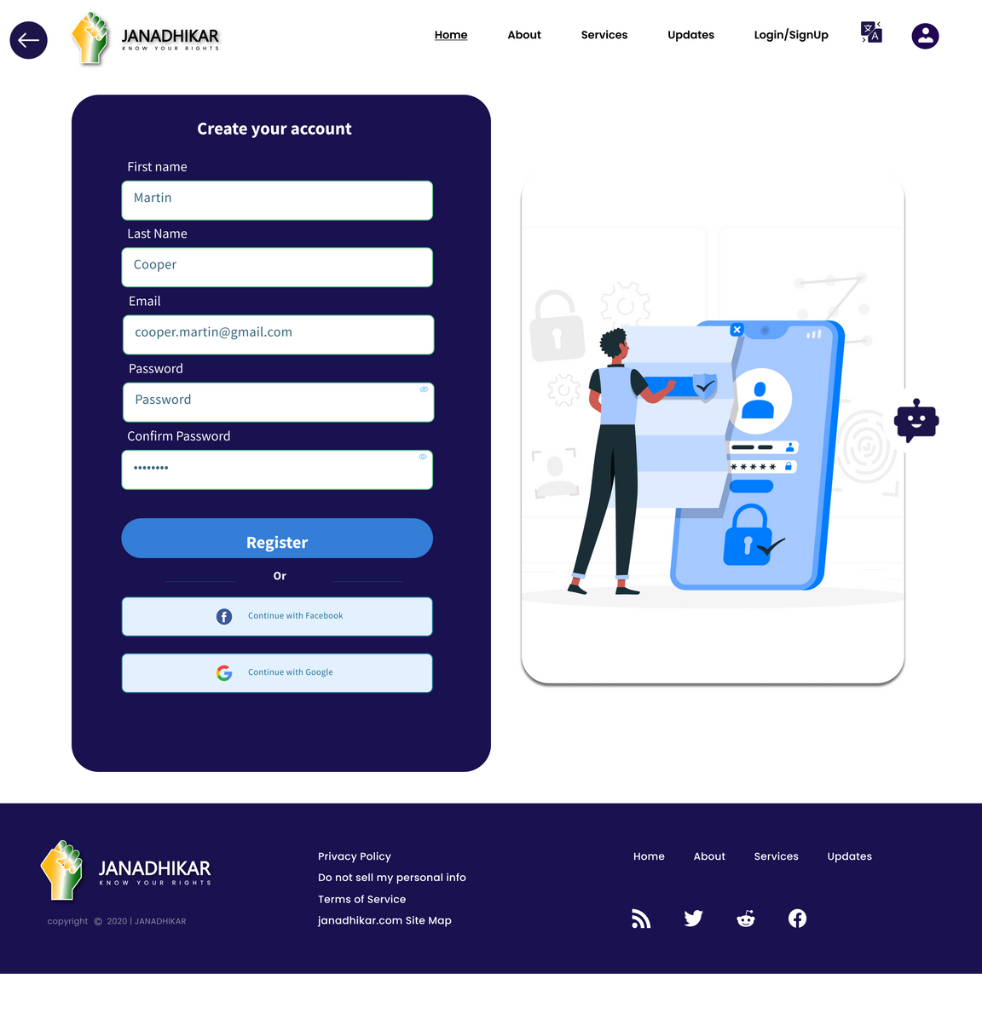
LOGIN /SIGNUP PAGE
login page
Sign Up page for the user

Slide 13

THANK YOU
SPEAK THE TRUTH,
Follow The Path
Of Rightness

